Slide 1
watsonx
Git Integration
development

Slide 2
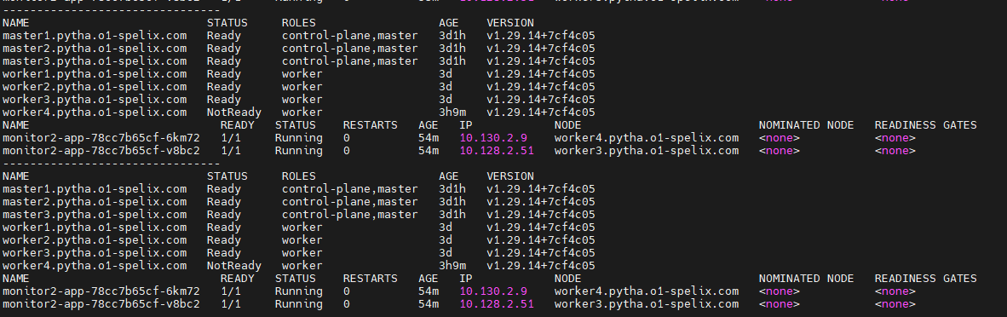
Worker4 node shutdown
1
2

Slide 3
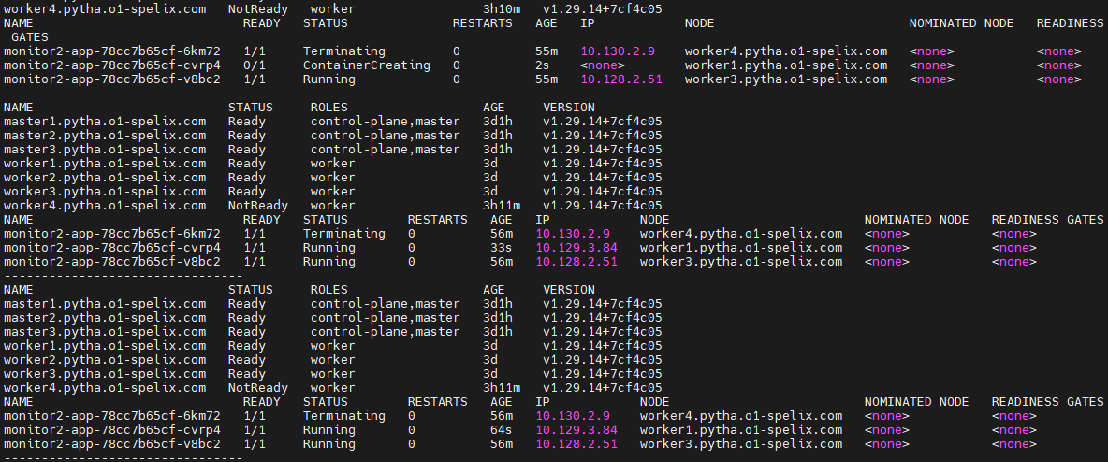
Pod recreation in worker1 node
1
2

Slide 4
Worker4 node restart
1
2
3
4

